Slide 1
Machine learning
Regent College London
SWE6204

Slide 2
Machine learning
SWE6204

Slide 3

Machine learning
POLYNOMIAL REGRESSION

Slide 4
Module 1 – polynomial regression

Slide 5
Learning objectives
Understand concept of Polynomial Regression
Understand the Overfitting
Understand techniques to overcome Overfitting

Slide 6
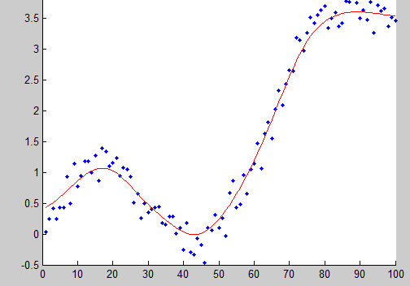
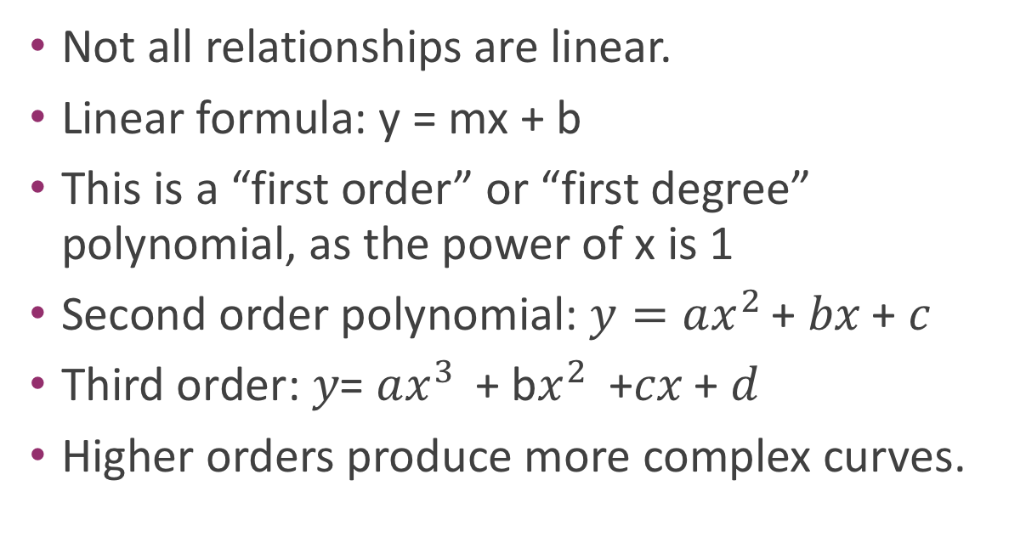
Why limit ourself to straight line
Not all relationships are linear.
Linear formula: y = mx + b
This is a “first order” or “first degree” polynomial, as the power of x is 1
Second order polynomial: $y=ax^{2 }$+ 𝑏𝑥 + 𝑐
Third order: 𝑦= $ax^{3 }$+ b$x^{2 }$ +𝑐𝑥 + 𝑑
Higher orders produce more complex curves.

Slide 7
Beware of overfitting
Don’t use more degrees than you need
Visualize your data first to see how complex of a curve there might really be
Visualize the fit – is your curve going out of its way to accommodate outliers?
A high r-squared simply means your curve fits your training data well; but it may not be a good predictor.
Later we’ll talk about more principled ways to detect overfitting (train/test)

Slide 8
Polynomial Regression
Polynomial Regression
Polynomial regression is a non-linear regression. In Polynomial regression, the relationship of the dependent variable is fitted to the nth degree of the independent variable.
Equation of polynomial regression:
Underfitting and Overfitting
When we fit a model, we try to find the optimised, best-fit line, which can describe the impact of the change in the independent variable on the change in the dependent variable by keeping the error term minimum.
While fitting the model, there can be 2 events which will lead to the bad performance of the model. These events are
Underfitting
Overfitting

Slide 9
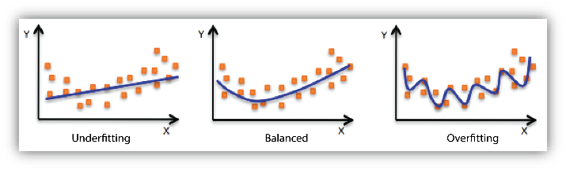
Underfitting
Underfitting is the condition where the model could not fit the data well enough. The under-fitted model leads to low accuracy of the model. Therefore, the model is unable to capture the relationship, trend or pattern in the training data. Underfitting of the model could be avoided by using more data, or by optimising the parameters of the model.
Overfitting
Overfitting is the opposite case of underfitting, i.e., when the model predicts very well on training data and is not able to predict well on test data or validation data. The main reason for overfitting could be that the model is memorising the training data and is unable to generalise it on test/unseen dataset. Overfitting can be reduced by doing feature selection or by using regularisation techniques.

Slide 10
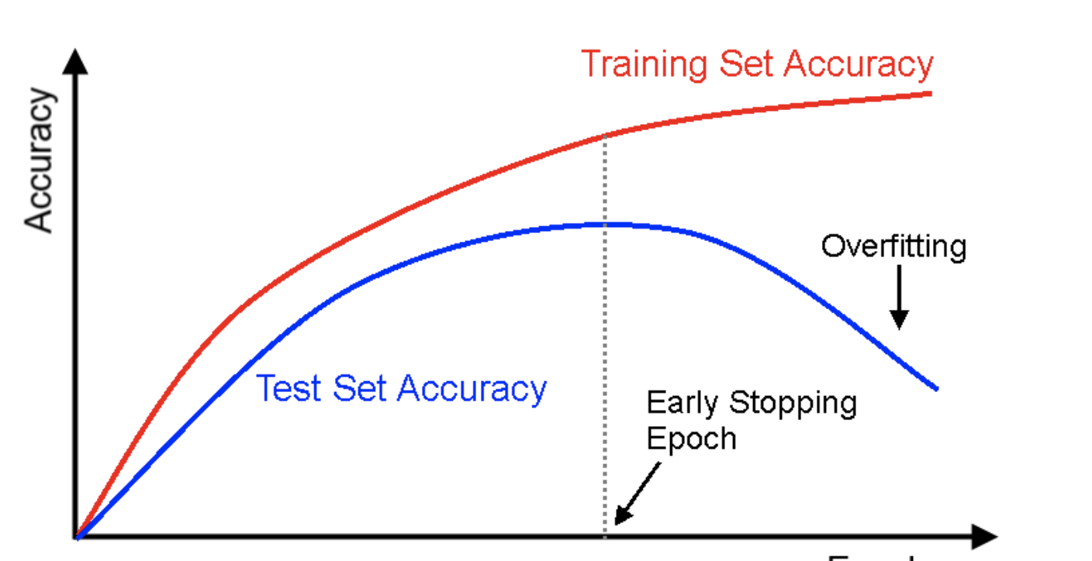
Overfitting

Slide 11
Python coding
Let’s play with an example
• numpy.polyfit() makes it easy.

Slide 12
REFERENCE
https://www.mygreatlearning.com/blog/linear-regression-in-machine-learning/
https://towardsdatascience.com/predicting-house-prices-with-linear-regression-machine-learning-from-scratch-part-ii-47a0238aeac1

Slide 13
+44 (0)207 016 8000
info@rcl.ac.uk

